Slide 1
Where to
Invest in
Philly?
Notes:
Welcome! Today we are looking at which zip codes in Philadelphia will provide the greatest returns on our investments.

Slide 2
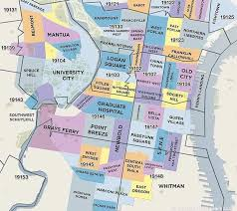
Problem Statement
Philadelphia is a diverse city.
Where should we be looking for opportunity?
Notes:
Philadelphia is a diverse city. It is comprised of many distinct neighborhoods, each with their own sense of culture and attitude. This sense of personality transfers over into the real estate of the city because each neighborhood has different trends and tendencies. Ultimately we need to be asking ourselves “Which areas of the city will afford us the greatest opportunity?”

Slide 3
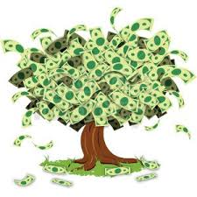
Business Value
Reduce risk
Plan out investments
Make our money grow
Notes:
There are many benefits to analyzing where we have investment opportunities.
First, we can reduce our risks. We can learn to recognize when a situation is not in our favor through projections on how the market is going to continue. When we see potential that a market will crash, we will know to stay away from that area and invest somewhere else.
We can also learn to plan out our investments. How long should we hold on to a property before selling? Is it always worth our while to have a quick turn around, or should we be holding on to properties to maximize our profit?
And finally, we can grow our assets. By maximizing where and when we buy and sell, we can constantly expand our capital.

Slide 4

Method
Notes:
The data that we used for this project was obtained from Zillow. We obtained the median home price for each neighborhood in Philadelphia broken down by month since 2012. Using these prices, we created predictions on how the price of homes in each zip code will change for the next three years. Let’s talk about the five that had the highest projected returns.

Slide 5
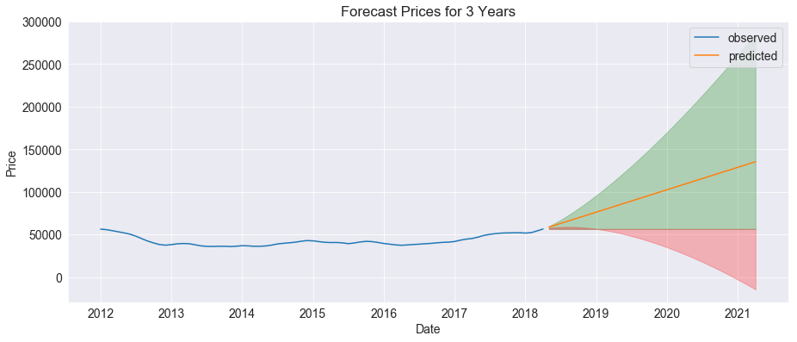
Zip Code 19142
Notes:
Zip code 19142:
Projected returns for 1, 2, 3 year periods: 46%, 93%, 139%
Projected risks: 6%, 18%, 24%
The cost of investing here is pretty minimal as well because the median house price is well below the average house price in Philadelphia. This seems like a very promising area of the city for investments, and we should definitely be taking advantage of that.

Slide 6

Zip Code 19124
Notes:
Next we have zip code 19124.
Returns for 1, 2, 3 year periods: 18%, 35%, 53%
Projected risk for 1, 2, 3 year periods: 7%, 18%, 24%
While the returns are a little lower in this zip code than in 19142, we still have high rates and low risk. We should absolutely add this area to our investment areas.

Slide 7
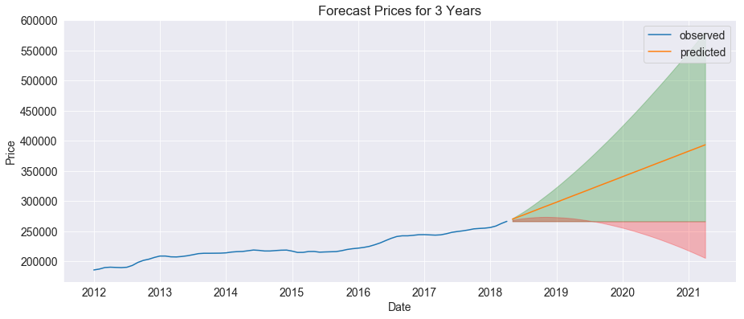
Zip Code 19119
Notes:
Continuing the trend, zip code 19119 also presents us with high expected returns.
Projected returns: 16%, 32%, 48%
Projected risks: -6%, 9%, 16%
The average price of homes is already quite high compared to the average in Philadelphia, which means we will need to use more of our assets to invest here, locking them into slightly lower potential return rates. I would suggest investing here, but I would still look for opportunities in 19142 first as we can invest in multiple properties there for the cost of one here, and would potentially see better growth.

Slide 8
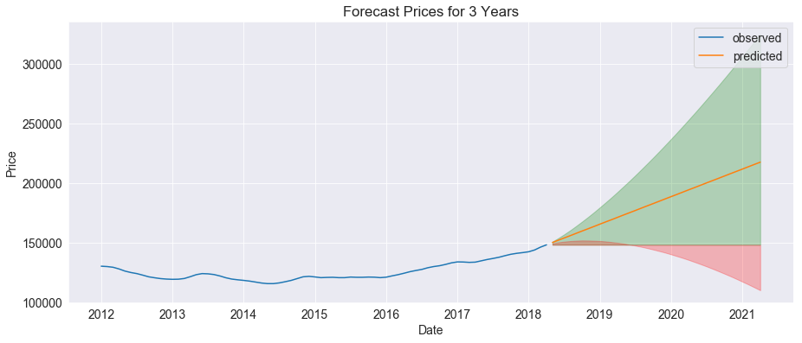
Zip Code 19136
Notes:
Zip code 19136 looks very similar to the other zip codes we have talked about. Projected returns: 16%, 31%, 47%
Projected risk: -4%, 11%, 18%
The average price for homes in this zip code is similar to the average home price for all of Philadelphia, so we won’t be buying in at a cheap price, but we will have a fairly safe investment and good returns.

Slide 9
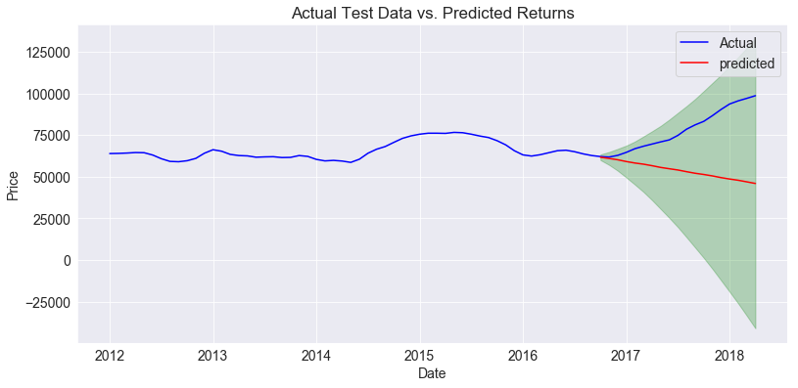
Zip Code 19131
Notes:
Finally we should talk about zip code 19131. While the projected returns from this zip code are fairly good at 18%, 36%, and 54% over three years, we could not get our model to perform well on accuracy tests. In the diagram shown here, our model, represented by the red line, ideally should closely match the blue line. Our model unfortunately could not accurately predict prices in this zip code for the last year, so we can’t expect its future predictions to be reliable. Therefore, while the projected rates of return are high, I do not recommend investing here until we develop a more reliable model.

Slide 10

Recommendations:
Invest in:
19142
19124
19119
19136
Avoid:
19131
Rerun models in 6 months
Notes:
So, let’s recap. Of the five zip codes that produced the highest predicted returns in Philadelphia, I recommend investing in four of them. Zip codes 19142, 19124, 19119, and 19136 represent high value investments for minimal risk. Of these I would strongly suggest investing in 19142 as the cost of investment is so low and the projected returns are very high. All zip codes represent reasonably safe investments for at least 1 year and then get inherently more risky. Currently we should not be investing in zip code 19131 as it is too risky to use a model that we can not trust.

Slide 11

Looking Ahead
Use more sensitive modeling procedures
Incorporate socio-economic information
Notes:
Before we finish up, let’s discuss expanding on this project. I think our next step should be incorporating some more sensitive models to see if we can get some slightly narrowed results from our models. This would allow us to further account for risk in our investments and could perhaps solve the issues we are having with our predictions in zip code 19131. Second, I would like to branch out from working with exclusively pricing information. By incorporating socio-economic data (such as tax rates and school districts) into our models, we can fine tune our model to get more specific predictions. And finally, we should create new projections in 6 months, so we can continue to monitor our investments.

Slide 12
Thank
You!
Notes:
Thank you for giving me the opportunity to talk to you all today. I’d be happy to answer any questions you might have. Also, if anybody would like a closer look at our project or data, I would be happy to provide you the information.

Slide 13
Appendix:
ROIs:
Zip code 19142: 46%, 93%, 139%
Zip code 19124: 18%, 35%, 53%
Zip code 19119: 16%, 32%, 48%
Zip code 19136: 16%, 31%, 47%
Zip code 19131: 18%, 36%, 54%
RMSE on test data:
Zip code 19142: 5599.65
Zip code 19124: 6113.03
Zip code 19119: 3826.64
Zip code 19136: 2552.82
Zip code 19131: 29383.75
Risk:
Zip code 19142: 6%, 18%, 24%
Zip code 19124: 7%, 18%, 24%
Zip code 19119: -%, 9%, 16%
Zip code 19136: -%, 11%, 18%
Zip code 19131: 29%, 34%, 57 %

Slide 14
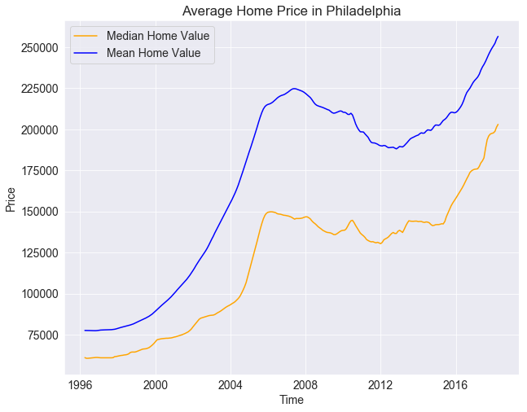
Appendix:
Average home prices in Philly:

